Slide 1


Team 37: Microhistological Analysis of the Dietary Habits of Sheep: GrazeView AI
Bi-Weekly Update 3
Godson Edewor, Arnav Gokhale, Jack Nelson, and Nate Scott Sponsor: John Lusher TA: Sabyasachi Gupta

Slide 2
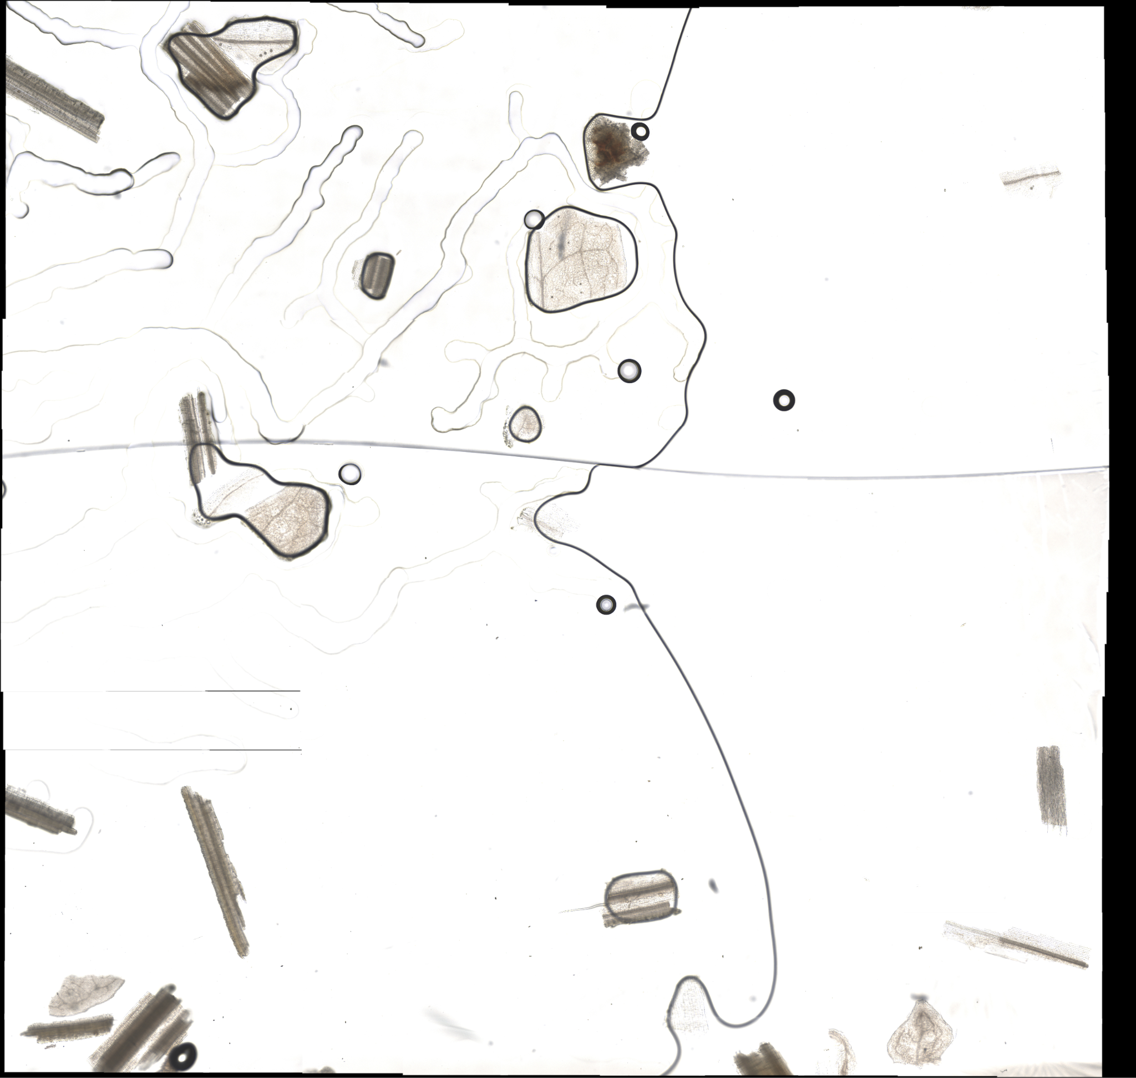
Project Summary
Problem Statement:
TAMU AgriLife is currently investigating the Dietary Habits of Sheep and the effect it has on their wool.
This can be a very time consuming effort, when analyzing microscopic samples by hand.
Solution Proposal:
GrazeView AI will allow the process of analyzing these microscope slides to become automated.
This will save TAMU AgriLife both time and money spent in training individuals that analyze by hand.

Slide 3
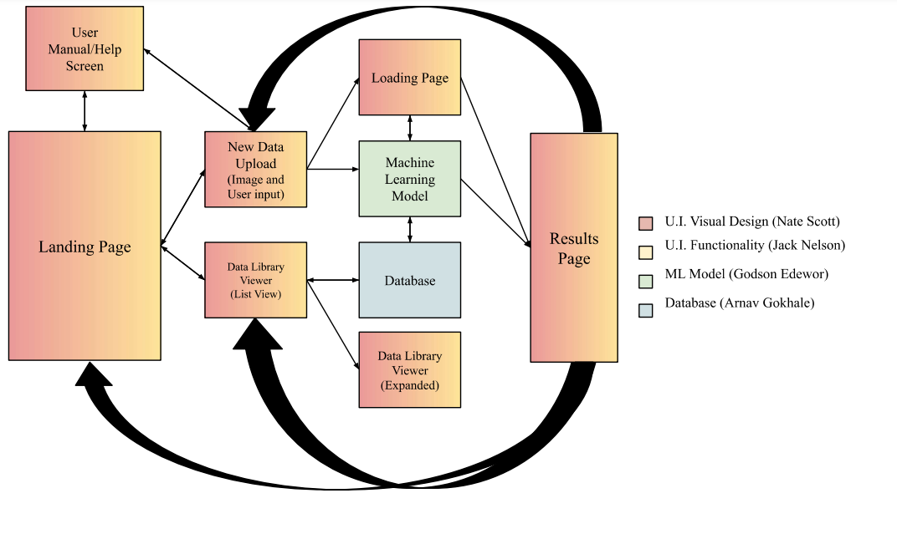
Project/Subsystem Overview

Slide 4
Project Timeline
Subsystem Final Validation (01/29) | Begin ML/UI Integration (02/03) | Finish ML/UI Integration Begin DB/UI Integration (02/17) | Finalize DB/UI Integration Fix Integration Errors (03/03) | Project-wide Validation (03/24) | Validate Until Demo | Demo and Report (04/16)
*All Dates represent completion

Slide 5
User Interface & Machine Learning
Godson Edewor, Jack Nelson, & Nate Scott
Accomplishments since last update [~20 Hours] | Ongoing progress/problems and plans until the next presentation
ML Model has been embedded within the application UI can pass uploaded images to the ML ML can pass the results back to the UI The loading page now provides real-time updates from the ML ML Results are stored within the Data Library in the UI | Adjust formatting between ML output and UI results Resolve C# and Python ONNX discrepancy Run feature descriptor (HOG)/backbone (ResNet 50) tests on model

Slide 6
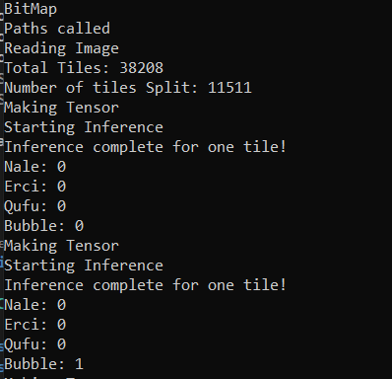
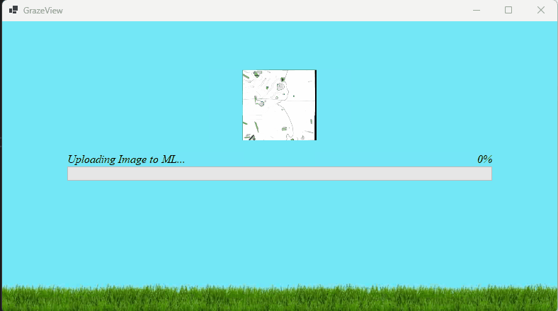
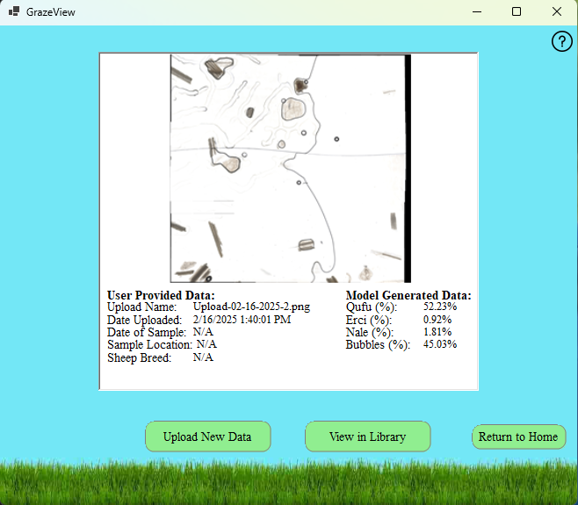
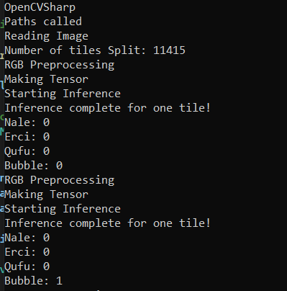
User Interface & Machine Learning
Godson Edewor, Jack Nelson, & Nate Scott

Slide 7
User Interface & Database
Full Team
Accomplishments since last update [~20 Hours] | Ongoing progress/problems and plans until the next presentation
Image DB fully functional CSV DB fully functional User can select files to view ex. “154HD_001” will display “154HD001.png” (image) & “154HD001.txt” (text - % split) Building blocks fully functional, ex. 1) Data Viewer, 2) DB automation, 3) Establish connection/disconnect U.I. able to show past uploads U.I. ready to integrate with DB U.I. has added functionality prepared to pass data with the DB | CSV DB reads output string from UI/ML, uploads to server UI sends “image01.png” to server, adds to ImgDB Test C# script as instructions for DB building blocks in UI Selected user account does not exist in Tenant (Restricted) error in Microsoft Azure [SQL Server]

Slide 8
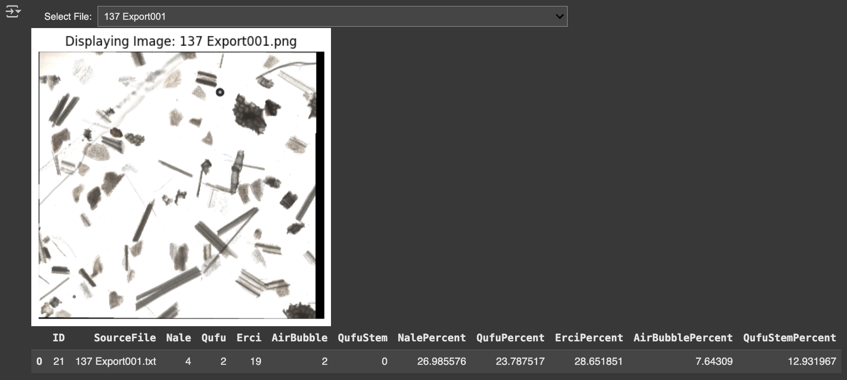
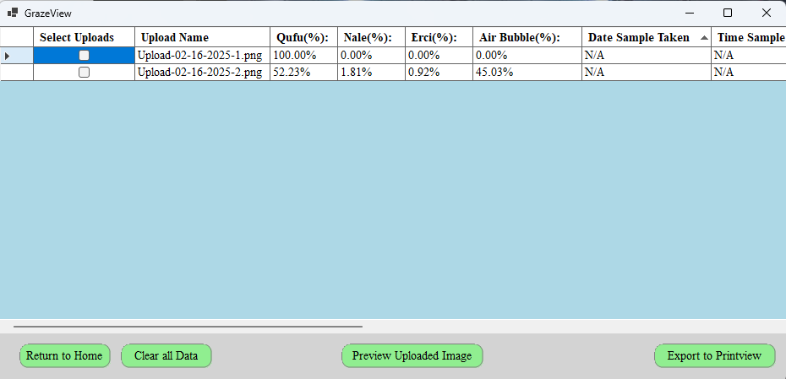
User Interface & Database
Full Team

Slide 9
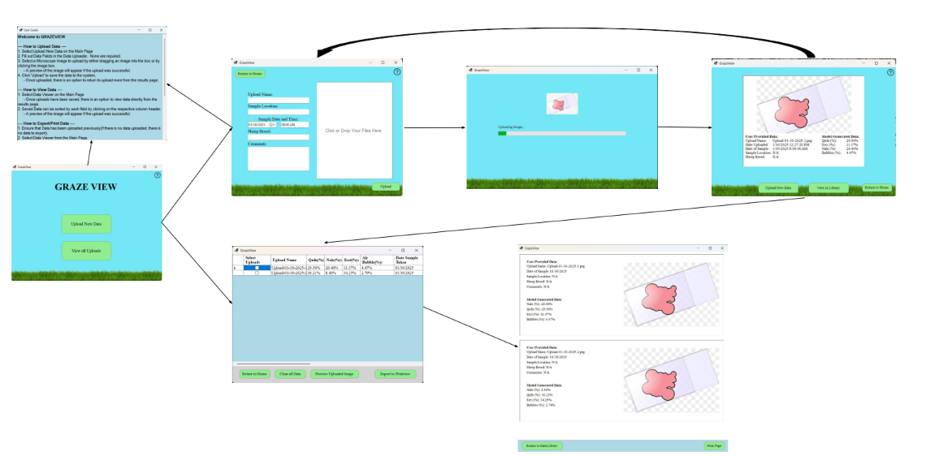
User Interface
Jack Nelson & Nate Scott

Slide 10
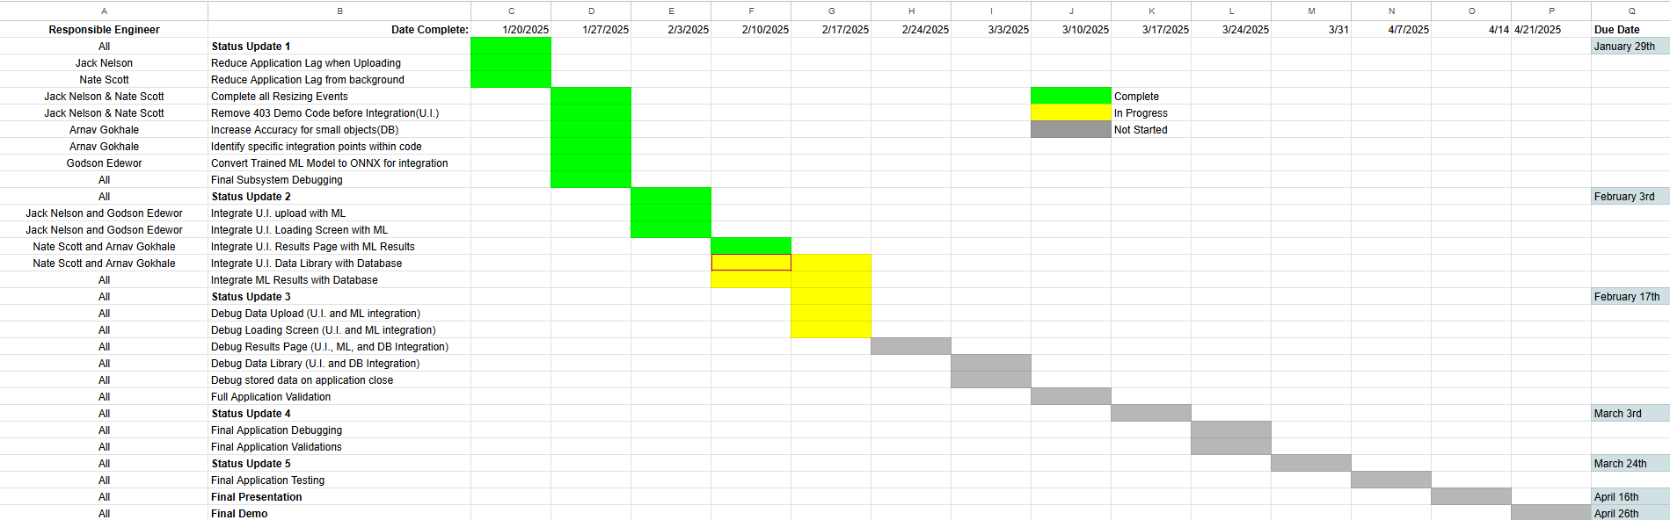
Execution Plan

Slide 11
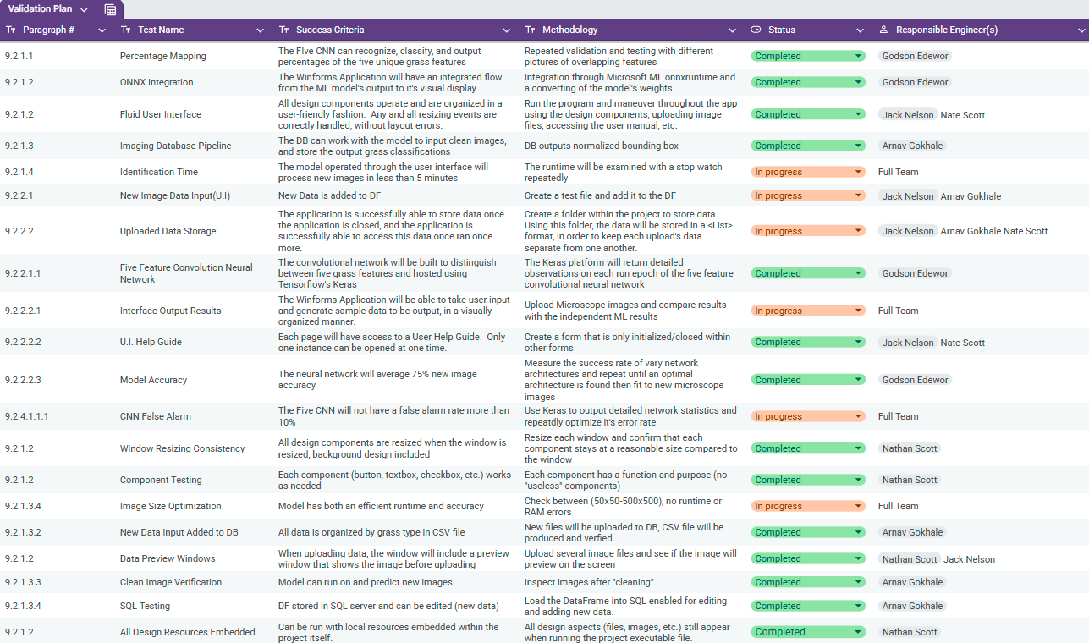
Validation Plan

Slide 12
Questions?

